Slide 1
PROJECTION WELDING MACHINE

Slide 2
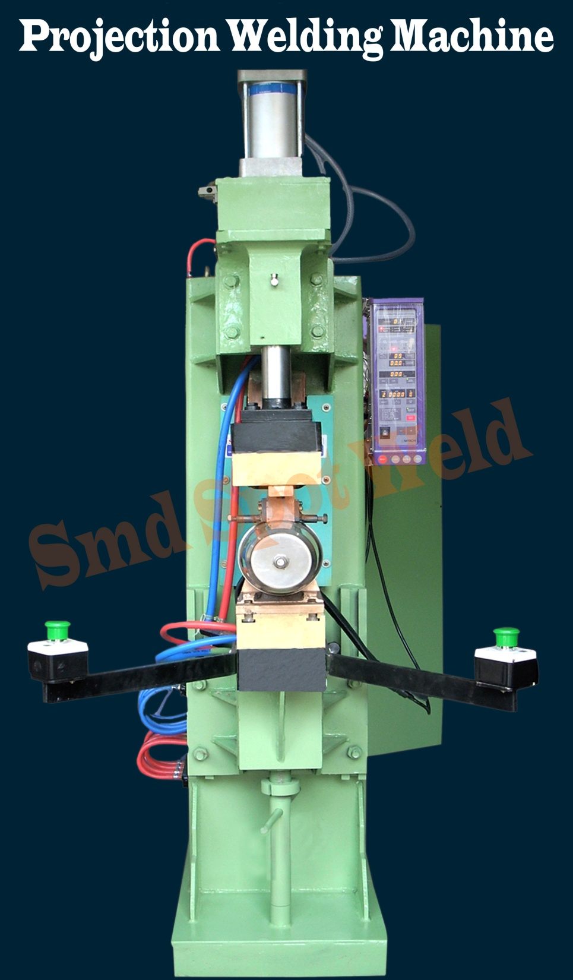

Slide 3
Projection Welding Machine
Model | Rated capacity at 50% | Phase & input voltage | Frequency | Duty cycle at max current | Max short circuit current projection @200 TD | Throat depth for projection | Top holder diameter
 |  |  |  |  |  |  | Diameter | Length
unit | KVA | Volt | HZ | % | A | MM | MM | MM
SPP-50 | 50 | 220/440V (2 phase) | 50/60 | 6.5 | 18,000 | 300 | 25 | 150
SPP-75 | 75 | 220/440V (2 phase) | 50/60 | 5.8 | 22,000 | 300 | 25 | 150
SPP-100 | 100 | 220/440V (2 phase) | 50/60 | 6.8 | 28,000 | 300 | 30 | 150
SPP-150 | 150 | 220/440V (2 phase) | 50/60 | 3.4 | 32,000 | 300 | 30 | 150
SPP-200 | 200 | 220/440V (2 phase) | 50/60 | 2.8 | 38,000 | 300 | 40 | 150

